Slide 1

Introduction
Esaren Global Ltd (EGL) is a leading entity having a multi-faceted business portfolio. Head-quartered in the UK and having branch operations in Bangladesh and Singapore– the company envisions to have a foot-print in a diverse range of business areas. Combining unparalleled experience, domain expertise, best practice referrals and comprehensive capabilities across various industries a n d business functions, the company collaborates with customers to help effectively, address operational challenges and grow stronger.
EGL is a concern of “Esaren International Group, UK ” and focuses mainly in the areas of:
Project Management Consulting (PMC)
Venture management & Joint Ventures

Slide 2

Mission
We aim to serve our clients strength to strength.
Vision
Our vision is to become the best version of ourselves, build a fraternity of partners and customers with purpose and efficacy.

Slide 3

Who we are
At EGL, our primary focus was development of projects, whereby we partner with Engineering, procurement and construction (EPC) companies to offer infrastructure and supplying support to project owners. From feasibility to project execution – we can provide a diverse range of services to satisfy our client’s requirements properly.
At second step we branched into start-up and venture development activities with a Singapore based Fund Management presence as well.
We can offer financing facilities to our clientele as well, which is in collaboration with our venture partners.

Slide 4
Our Global footprint and responsibility matrix
London
Group HQ.
Part of Esaren international Group
All corporate, financing, legal & compliance – activities handled from here
Singapore
Our HQ
All fund management business development & market operations – activities handled from here
Guangzhou
Project management Office (PMO)
All engineering, procurement & construction activities managed from here
Lagos
Our back-end office
Internal co-ordination, support services and venture support provided from here.
Ms. Diana Sachirciuc is the key personnel here and we have in total handled a total project value of USD 290 million from here.
Currently, a further 330 million is under consideration.
Mr. Kelvin Chan is in-charge of this office and provides the global positioning of the company.
Our clientele across 20+ countries are looked after diligently from this location.
Engr Hong Li Guo handles all EPC oriented support from this location with other globally dispersed team members to support him in this endeavour. The PMO also manages all ongoing projects.
All back-end support is being handled form Lagos for the global footprint of the company. Mr. Taofik Adeleke with his immense experience, has formulated a team for such engagement.

Slide 5
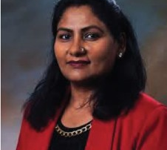
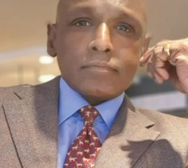
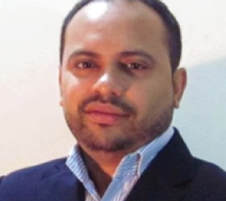

Our leadership team
Naila Chowdhury
Suresh Sivarajah
Ruhsan Rahman
Catherine Wong
Chairperson
A Global leader, entrepreneur and social activist - based out of San Diego, USA. 35+ years of experience in telecom, development, investment, technology, etc. She also sits at board level with different other global entities as well
Vice Chairman
35+ years of experience in energy, trading, real estate and finance. Based in London, UK and founder & CEO of Esaren International Group. A graduate from prestigious Wellington College, Suresh is a global entrepreneur.
Managing Partner
Ruhsan is a business developer, strategist and investment expert. He has a 30+ years of background in technology, energy, infrastructure development and investment.
Sr. Partner
Catherine is a former investment banker and also was part of a venture capital for almost 20+ years. She is now a part of our fund management team based out of Singapore offering fund management and Special Purpose Vehicle (SPV) support for projects

Slide 6
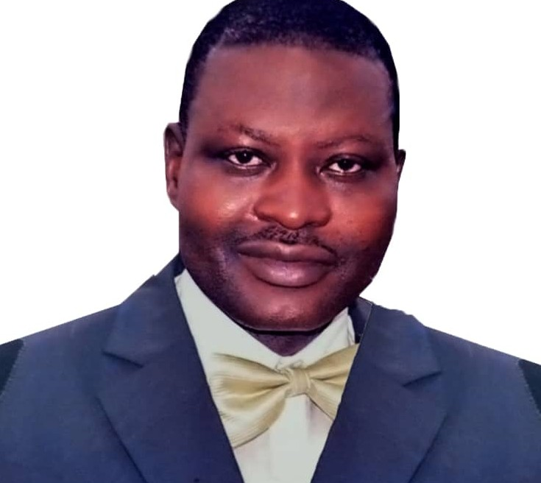
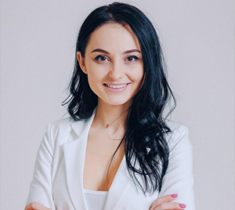
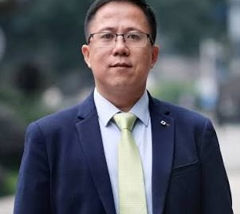
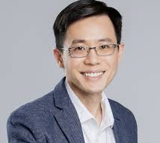
Our core management team
Taofik Adeleke
Diana Sachirciuc
Engr. Hong Li Guo
Kelvin Chan
Country Director
Nigeria
Based out of Lagos, Taofik manages our overall back-office for global operations and leads projects in the African region.
Country Director
United Kingdom
Based out of London, Diana coordinates for our financing management with global partners and handles legal & compliance matters
Country Director
China
Based out of Guangzhou, Engr. Hong handles our engineering, procurement and construction (EPC) support for all global projects
Country Director
Singapore
Based in Singapore city, Kelvin manages our fund management, trade and regulatory matters. EGL is registered in Singapore and the company identities related matters are handle here

Slide 7
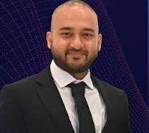

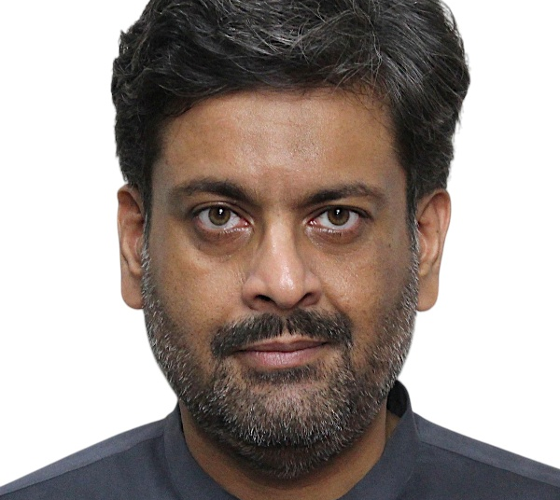
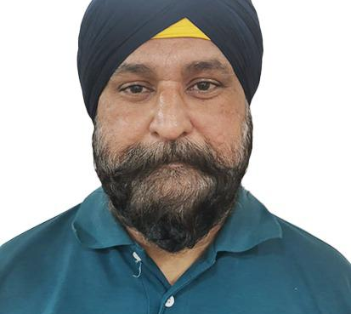
Our core operations team
Sadat Omi
Olga Ignatieva
Rizwan Y. Khan
Jasvinder Singh
Director
Strategy & Coordination
Sadat is based out of Bangladesh and provides us with the strategic guidance for all operations as well as coordination between a diverse team of EGL globally dispersed in 7 locations
Director
Finance & Investment
Based out of Estonia, Olga handles our financial management and investment opportunities whereby she works with our global partners
Director
Business Development
Based in Pakistan and Singapore, Rizwan manages our global business development and the post closure relations for each project & venture
Director
Market Operations
Jas, as we call him, is based in Singapore and handles our all global marketing endeavours. His team handles digital presence of the company and branding

Slide 8
Our core activities
Project Management Consulting

Slide 9
Our key competencies for Project Management
EGL focuses on the consulting aspects of Construction & Communication Engineering (Road & Highways, Bridge, Steel Structures, Telecom etc.) as a market leader. The company has been involved in major construction & telecom service providing sectors in countries like Bangladesh, Turkey, Vietnam, Indonesia and Sri Lanka.
EGL offers integrated, end-to-end, future-ready construction & telecommunication solutions that major partners rely upon for delivering revenue-generating services. We have has earned a reputation for rendering uncompromising quality, flexibility and on time-bound budget based solutions. Known for our ability to translate client needs into scalable, flexible, cost-effective solutions, EGL builds project that increases the value of our partner’s network infrastructure and reduce operating expenses.
From construction, basic network infrastructure services to planning, coordinating and implementing complex construction, network integration projects, EGL’s experience, professionalism, and efficiency, allows for unparalleled performance. With an unique team of industry leading talent, we have built and implemented a menu driven service model that allows our clients the maximum amount of flexibility when addressing their networking needs.

Slide 10
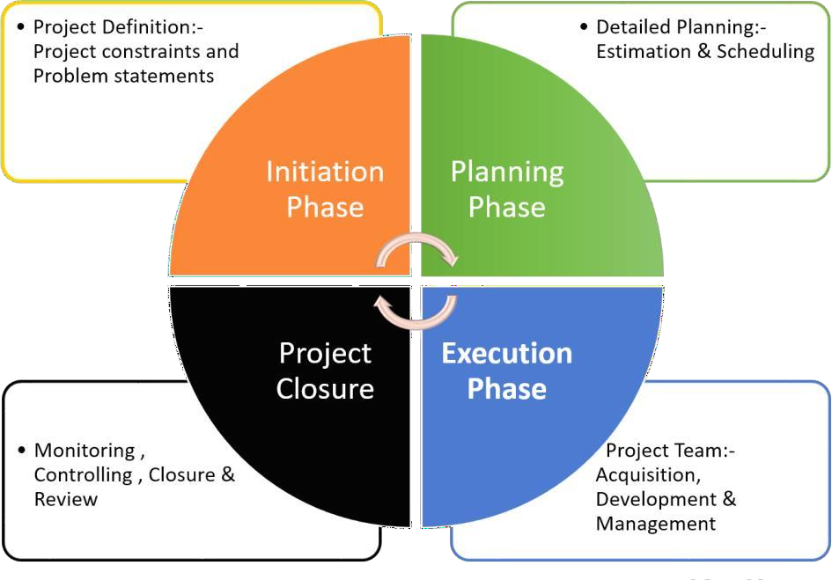
Project Management Consulting Cycle

Slide 11
Our stakeholders’ procedure:
In order to successfully accomplish a project, EGL follows a strong adherence of the process flow in connecting all necessary stakeholders. From initialization to completion, EGL tags with required partner to properly and successfully execute a project. A possible step by step approach could be
Primary phase: Evaluation phase:
Execution phase:
Determining feasibility
Creation of the Project Management Office (PMO)
Setting of budget
Proposing the client a proper guideline for execution
Allocating relevant
Manpower
Possible involvement of a JV partner in defining and planning a project
Joint allocation of resources
Creation of banking channels, if required
Mobilization of 3rd party stakeholders
Assign an EPC (Engineering, Procurement & Construction partner, if required
Finalize and create a project funding funnel (i.e. Special Purpose Vehicle, if required)
Define a possible execution roadmap with all stakeholders
Monitor and manage project
as per agreed timeline
Managed internally
Managed jointly with JV partners or 3rd party groups
All stakeholders need to adhere to strict compliance

Slide 12
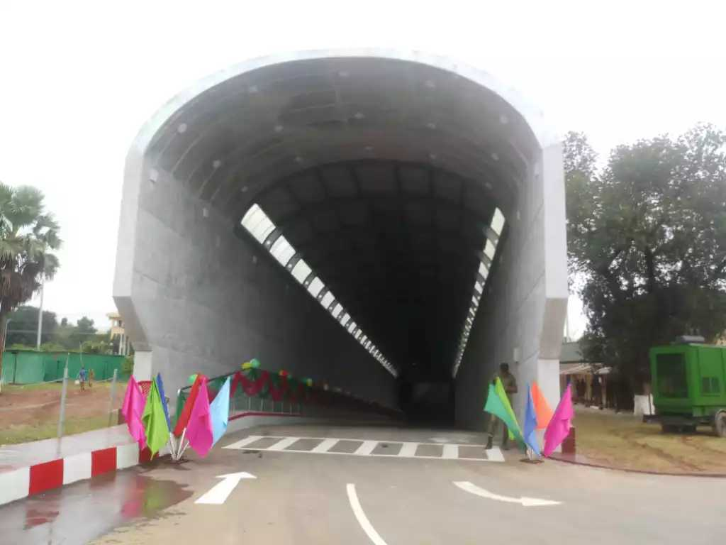
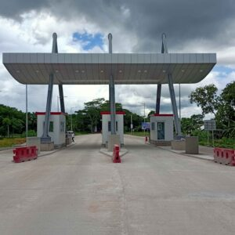
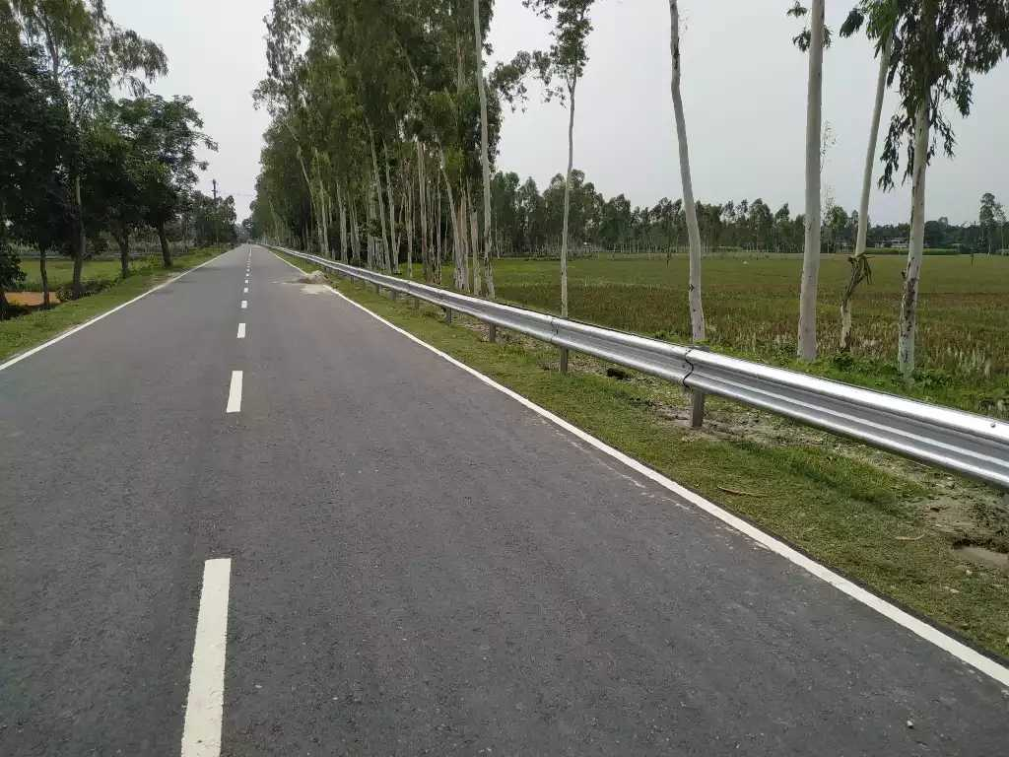
Our key expertise
  Our key expertise in consulting for infrastructure sector:
Road & Bridge Construction
Vehicular underpass construction
Existing Bridge Rehablitation
Foot Over Bridges & Passenger Shed
Guard Rail & Street Light Post
Prefab Toll Plaza with Canopy
RCC Tall Building Construction
Gantry Road Sign & New Jersey Barrier
Prefabricated Steel Building
Telecommunication High Towers
BTS Installation & Commissioning
Earthing & Fire Fighting System Supply & Installation
Transmission Line Towers (RC & ANC)
Development Contractor

Slide 13
Our core activities
Venture Management & Strategic Partnerships

Slide 14
Venture management & Strategic Partnerships
Roles for Venture Management:
As venture management partners, supports start-up and small to medium entities in - planning, development, fund management and execution.
We also have a role of a technical partner whereby we cover a subject matter providing the knowledge and management whereby the Founders can focus on proper operations and growth.
At EGL, we can provide fund management support via our setup in Singapore.
Roles for Strategic Partnerships
As a Strategic partnership facilitator, EGL plays a major role in feasibility study, planning, financing and operations management In collaboration with a Partner.
As a Stakeholder partner, we offer curated legal, financing and Engineering services, if required, as well.
We provide knowledge based expertise as well for certain partnerships as well as offering government entities with Public-Private- Partnerships.

Slide 15
Our Strategic Partners
Whitespace, Canada: This is a strategic collaboration that focuses on tech development, system integration and project partnership for a diverse range of technology based projects. www.whitespaceint.ca
Zenith Advisory, Singapore: Zenith is a corporate services and fund management provider. https://www.zenith-ventureadvisory.com
AltiusApp, Bangladesh: Altius offers health training, curated diet and personalised fighting training at home and preferred locations.
Citius Training, Bangladesh: Citius is a training and upskilling platform offering globally acclaimed certification and programs for skill development and the vocational sectors.
Fortius Engineering Services, Turkey: Fortius offers engineering and EPC based services to it’s clientele in collaboration with EGL.
Orient Healthcare, Global: This is a health platform that offers diagnostic and pharmaceutical services in partnership with hospitals on ground. The company also offers medical tourism and mental health support.
Ural Air, Bangladesh: This is a private airline, the first of its kind in Bangladesh. The airline is scheduled to commence operations from December 2026 and is pending flight operation permits\partnerships.

